Slide 1

Cuisine type in Madrid, Spain

Slide 2
What type of cuisine is available to a tourist in Madrid, Spain?
Madrid mostly has Spanish or Tapas restaurants but there are also other types of cuisines that may be of interest to tourist.
Other cuisines are Chinese, Asian, Argentinian, Brazilian, French, Mediterranean, Middle Eastern, Sushi and Seafood.
Type of restaurant may be dependent on the district area

Slide 3
Data acquisition and cleaning
Data table for districts and wards of the city of Madrid from https://en.wikipedia.org/wiki/Districts_of_Madrid
There were 22 rows and 7 column in the raw dataset
Null values are excluded and unnecessary columns for analysis were dropped
Clean data has 20 rows and 3 columns

Slide 4
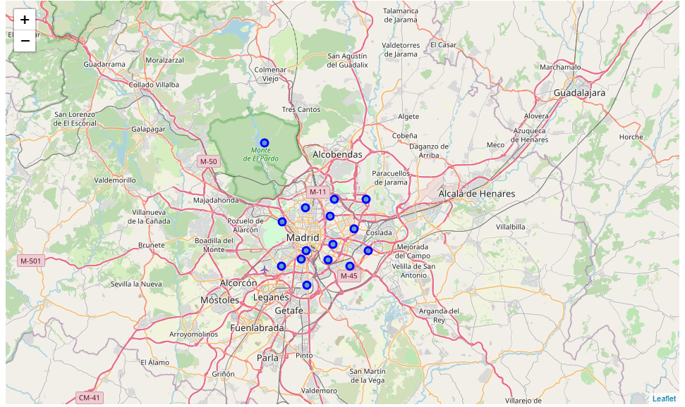
Districts in the city of Madrid

Slide 5
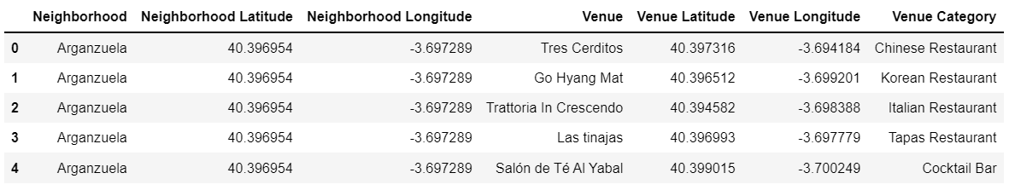
In Arganzuela district, we find these venues

Slide 6
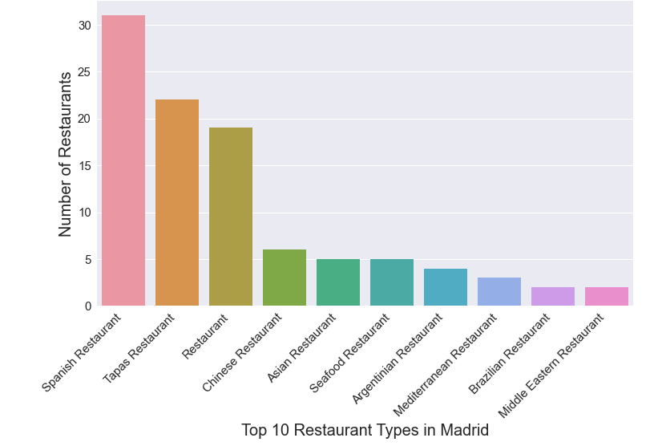
Top 10 types of restaurants in Madrid

Slide 7
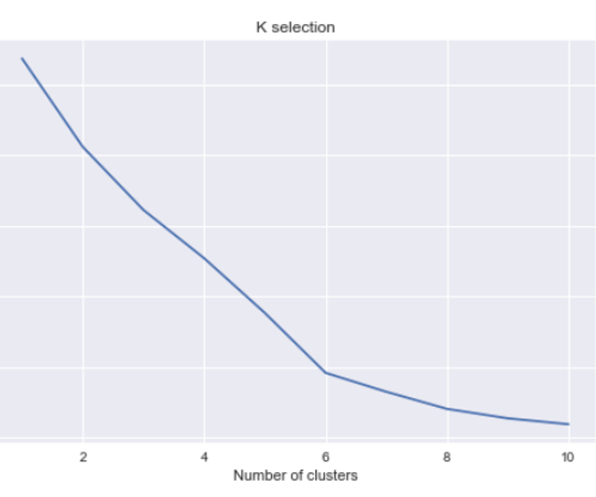
Use K-means for clustering the restaurants
In elbow method plot, k value which shows optimal number of clusters is 6

Slide 8
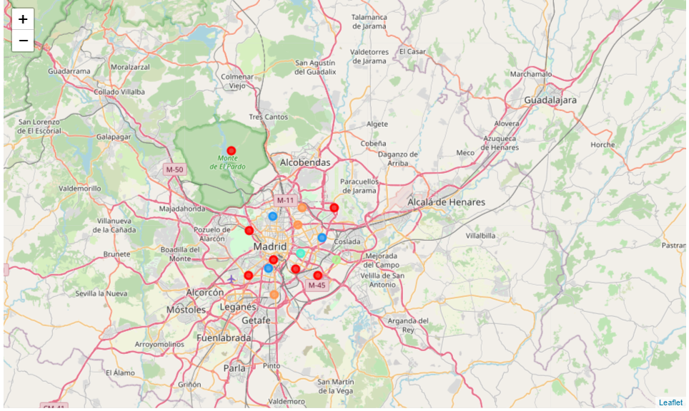
Folium map shows 6 distinct clusters in different colors

Slide 9
Most common restaurant in the 6 clusters
Cluster 1 - Mediterranean restaurant in Vicalvaro district
Cluster 2 - Spanish, Tapas, Asian and Seafood depending on which district
Cluster 3 - Sushi restaurant in Moratalaz district
Cluster 4 - French restaurant in Chamberi district
Cluster 5 - Spanish restaurant in Hortaleza and Villaverde district
Cluster 6 - Tapas restaurant in Villa de Vallecas district

Slide 10
Comparing the districts
Barajas district has the greatest number of restaurants, followed by Salamanca, Tetuan, and Arganzuela
Visualize it using Folium map

Slide 11
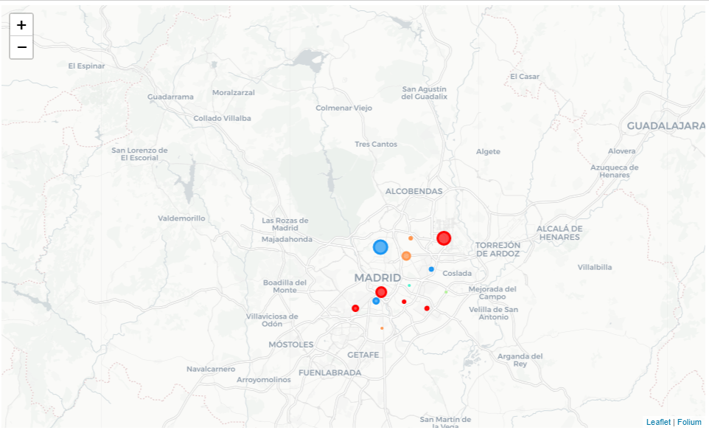
Folium Map showing Barajas has the highest number of restaurants

Slide 12
Conclusion
There are many Cuisine types to choose from for a tourist visiting Madrid, Spain
The chances of finding cuisine of your choice increases with the district that has highest number of restaurants like Barajas, Arganzuela and Salamanca
French, sushi or Mediterranean restaurant may be found in certain districts

